Slide 1
SKILL AND JOB RECOMMENDER
Team ID:
PNT2022TMID23044
Team Leader:
Ramya.V
Team Members:
Kirthana.B
Sreekrishna.B
Subhashree.S
Mentor:
Mr.K.Azarudeen,B.E,M.E
Department of Computer Science & Engineering
Velammal College of Engineering and Technology

Slide 2
Problem Definition
The user and their information are stored in the Database. An alert is sent when there is an opening based on the user skillset. To develop an end-to-end web application capable of displaying the current job openings based on the user skillset. Users will interact with the chatbot and can get the recommendations based on their skills. We can use a job search API to get the current job openings in the market which will fetch the data directly from the webpage.
Department of Computer Science & Engineering
Velammal College of Engineering and Technology

Slide 3
Survey Paper-1
Author:
Willy Wize A.Z
Gati Gayatri
Title:
The Dynamic of Digital Skills Demands-an Analysis on Three Job Marketplace Platforms
Published Journal:
IEEE
Published Month:
October
Published Year:
2021
Department of Computer Science & Engineering
Velammal College of Engineering and Technology

Slide 4
Objective:
Ensuring rural communities to have an equal chance with urban communities in developing their digital skills is a great challenge. The challenge is much greater in the situation of fast advancing digital technology and of lacking ICT infrastructure in rural areas. Our objective is to suggest skills to the rural communities based on the job they want to do.
Critical Findings:
Merits:
Everyone irrespective of rural and urban can have equal opportunity to develop their skill to achieve their goal.
Demerits: It can also have disruptive effects, with the marginalization of actors that cannot cope with the change. When developing a novel system for rural areas, requirements engineers should carefully consider the specific socio-economic characteristics of the domain.
Department of Computer Science & Engineering
Velammal College of Engineering and Technology

Slide 5
Survey Paper-2
Author:
Saju Mohanan
Sunitha Cheriyan
R. K. Rajesh
Title:
Deploying Smart Academy: A cloud integrated methodology to develop smart IT graduates to meet the ICT enabled industrial needs in Middle East
Published Journal:
IEEE
Published Month:
August
Published Year: 2017
Department of Computer Science & Engineering
Velammal College of Engineering and Technology

Slide 6
Objective:
Cloud computing is becoming as an imperative element for any organizational setup, as a service based cloud model to meet the education oriented technological needs of academic institutions. This paper tells a model based approach to equip the students to improve their skills based on needs of the industrial standards. This will help in the improvement of the current educational system and it will balance the requirements of the industrial jobs.
Critical Findings:
Merits:
Helps to improve skills based on current industrial standards.
Demerits: One of the demerits of skill based training is if that particular technology gets down in future, the individual can’t go for other job.
Department of Computer Science & Engineering
Velammal College of Engineering and Technology

Slide 7
Survey Paper-3
Author:
Amber Nigam
Aakash Roy
Hartaran Singh
Title:
Job Recommendation through Progression of Job Selection
Published Journal:
IEEE
Published Month:
December
Published Year:
2019
Department of Computer Science & Engineering
Velammal College of Engineering and Technology

Slide 8
Objective:
Introducing a novel machine learning model which uses the candidates job preference to incorporate the dynamics associated with highly volatile job market. The model has been developed and deployed in a real-world job recommender system and the best performance of the click-through rate metric has been achieved through a blend of machine learning and non-machine learning recommendations.
Critical Findings:
Merits: It generates serendipitous recommendations and solves the cold-start problem for new jobs and new candidates.
Demerits:
Analysing large amount of data and storing data is tedious to maintain.
Department of Computer Science & Engineering
Velammal College of Engineering and Technology

Slide 9
Survey Paper-4
Author:
Nikolaos D. Almalis
George A. Tsihrintzis
Nikolaos Karagiannis
Title:
A content based approach for recommending personnel for job
positions
Published Journal:
IEEE
Published Month:
July
Published Year:
2014
Department of Computer Science & Engineering
Velammal College of Engineering and Technology

Slide 10
Objective:
A content-based approach that takes into consideration an organization's needs and the skills of candidate employees in order to quantify the suitability of a candidate employee for a specific job position. So, a three step experimental evaluation, namely, content analysis, refinement of the algorithm, and execution is conducted and the results of this experiment show that recommender systems can play an important role in the area of job seeking and recruiting.
Critical Findings:
Merits: It matches recruiters and candidates based on inferring implicit preferences on companies/recruiters and matching them with the attributes of candidates using a vector space model for representation.
Demerits: Some studies only used university datasets, however, the details such as the students have no relevant practical experience in their fields are missed out.
Department of Computer Science & Engineering
Velammal College of Engineering and Technology

Slide 11
Survey Paper-5
Author:
Hai-Hui Wang
Chalothon Chootong
Ankhtuya Ochirbat
Worapot Sommool
Title:
Online courses recommendation system based on industry occupation skills requirements
Published Journal: IEEE
Published Month: August
Published Year: 2017
Department of Computer Science & Engineering
Velammal College of Engineering and Technology

Slide 12
Objective:
MOOCs had bring us to a higher education with the concept of flipped classrooms, where students make use of the online studying materials such as online textbooks, video tutorials, and all sorts of documents which may take in forms of a web page, online learning platform, educational learning management systems. Therefore the students have plentiful self-studying resources from the internet, so that the students to learn and empower themselves correctly.
Critical Findings:
Merits: With online courses students can study in their own time and they can study specifically for the domain.
Demerits: One of the demerits of online courses is that students should select the course correctly or someone should guide them.
Department of Computer Science & Engineering
Velammal College of Engineering and Technology

Slide 13
Survey Paper-6
Author:
Sisay Chala
Madjid Fathi
Title:
Job seeker to vacancy matching using social network analysis
Published Journal:
IEEE
Published Month:
March
Published Year:
2017
Department of Computer Science & Engineering
Velammal College of Engineering and Technology

Slide 14
Objective:
Social network analysis is the investigation of social structures by using methods such as graph theory and machine learning. Social networks characterize networked structures in terms of nodes (i.e., individuals) and their relationships to each other as acquaintances, colleagues, collaborators and/or classmates. Through these relationships, one can find their ties with their connections, professions, and the degree of the ties.
Critical Findings:
Merits: To identify methods that measure the skills, expertise and experience of a job seeker and to investigate importance of using social networking data as input to user modeling that determines the strength of skills to be used matching job vacancies.
Demerits: Through Social network the competition for the job vacancy will be much higher.
Department of Computer Science & Engineering
Velammal College of Engineering and Technology

Slide 15
Survey Paper-7
Author:
Betty Dewi Puspasari
Lany Lukita Damayanti
Andy Pramono
Aang Kisnu Darmawan
Title:
Implementation K-Means Clustering Method in Job Recommendation System
Published Journal:
IEEE
Published Month:
October
Published Year:
2017
Department of Computer Science & Engineering
Velammal College of Engineering and Technology

Slide 16
Objective:
Work is important for everyone to earn income. With the large number of new graduates each year, finding job vacancies is a problem for students who have just completed their studies. Applications in the form of websites that become third parties for companies and applicants. The recommendation system in this application will calculate the level of match of the applicant’s main skills, salary, location, and other skills with the needs of the company.
Critical Findings:
Merits: Instead of applying company individually by our own, we can register through these websites and we can automatically get several companies based on our skills.
Demerits: While applying via third party the applicant should pay for the third party.
Department of Computer Science & Engineering
Velammal College of Engineering and Technology

Slide 17
Survey Paper-8
Author:
Ying Sun
Fuzhen Zhuang
Hengshu Zhu
Hui Xiong
Title:
Cost-Effective and Interpretable Job Skill Recommendation with Deep Reinforcement Learning
Published Journal:
ACM
Published Month: April
Published Year: 2021
Department of Computer Science & Engineering
Velammal College of Engineering and Technology

Slide 18
Objective:
Nowadays, as organizations operate in very fast-paced and competitive environments, workforce has to be agile and adaptable to regularly learning new job skills. However, it is nontrivial for talents to know which skills to develop at each working stage.The aim to develop a cost-effective recommendation system based on deep reinforcement learning, which can provide personalized and interpretable job skill recommendation for each talent.
Critical Findings:
Merits: Based on the environment, it design a Skill Recommendation Deep Q-Network (SRDQN) with multi-task structure to estimate the long-term skill learning utilities.
Demerits: To choose which skill to develop at each stage of his/her career is a difficult task.
Department of Computer Science & Engineering
Velammal College of Engineering and Technology

Slide 19
Survey Paper-9
Author:
Juhi Dameliya
Nikita Desai
Title:
Job Recommender Systems: A Survey
Published Journal:
IEEE
Published Month:
January
Published Year:
2020
Department of Computer Science & Engineering
Velammal College of Engineering and Technology

Slide 20
Objective:
Internet based recruiting platforms have become a primary channel in most companies for recruiting talents. Job portals using traditional information retrieval techniques such as Boolean search methods are typically using simple word matching algorithms. The main issue of these portals is their inability to understand the complexity of matching between candidates desires and organizations requirements. Hence, a vast amount of deserving candidates misses the opportunity to get an appropriate job. Aim is to suggest right job for right candidate.
Critical Findings:
Merits: Using internet based recruiting platforms both the company and applicant can save their time and no need to travel. Using this we can attend company from any part of the world.
Demerits: Candidiate can miss their opportunity for silly reasons like internet issue, Shutdown, etc.
Department of Computer Science & Engineering
Velammal College of Engineering and Technology

Slide 21
Survey Paper-10
Author:
Aritra Gosh
Andrew Lan
Title:
Skill-based Career Path Modeling and Recommendation
Published Journal:
IEEE
Published Month:
March
Published Year:
2021
Department of Computer Science & Engineering
Velammal College of Engineering and Technology

Slide 22
Objective:
The development of new technologies at an unprecedented rate is rapidly changing the landscape of the labor market. In this paper, a novel and interpretable monotonic nonlinear state-space model to analyze online user professional profiles and provide actionable feedback and recommendations to users on how they can reach their career goals is proposed. More importantly, our aim is to give a model which is interpretable and can be used for other important tasks including skill gap identification and career path planning.
Critical Findings:
Merits: Following this model, workers can build a successful career by acquiring new skills at right time.
Demerits: one of the demerits is finding a long term career skills is a difficult task.
Department of Computer Science & Engineering
Velammal College of Engineering and Technology

Slide 23
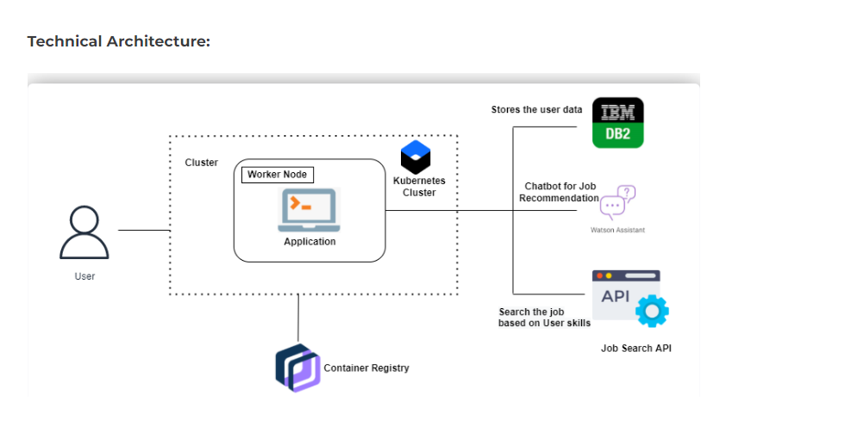
TECHNICAL ARCHITECTURE
Department of Computer Science & Engineering
Velammal College of Engineering and Technology

Slide 24
Thank You!
Department of Computer Science & Engineering
Velammal College of Engineering and Technology

